Slide 1
EM680
Organizations and Structure
Paul Wojnicki, PhD
SSE
2018

Slide 2
Knowledge Objectives
Define key elements of organizational structure
Explain structure relates to other corporate and business variables (size, technology, & environment).
Organizational culture

Slide 3
Grading
Class Participation 200 points (20 %)
Team Project 500 points equally split between the two projects (50 %)
Exam 300 points (30 %)
Submit assignments on time
Participate to the class discussions/activities
Contribute to the team projects

Slide 4
Course Contents
Organizational factors
(structure, culture, politics, change)
Class 2, 10 & 13
Organizational success
Productivity & satisfaction of individuals and groups
Class 8, 11
Class 3-7, 9
Individual
factors
(decision making, learning, motivation, …)
Group
factors
(leadership, communication, decision making, teamwork,…)
(adapted from Hitt, Colella and Miller., 2009)
Notes:
The importance of teams: organizational performance is increasingly influenced by teams rather than exceptional individuals or “strategic” design
Changes in individuals may not translate at the organizational level because teams have a great influence in empowering or hindering individual actions
Top down, strategic design is less and less effective because rational, long term planning is questioned by rapid changes

Slide 5
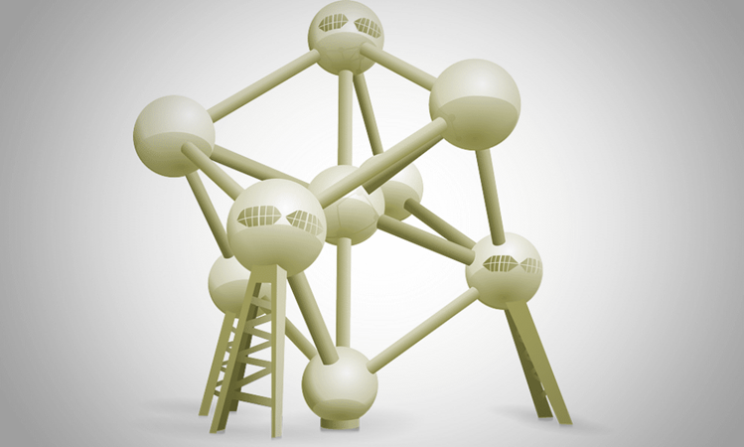
Organizational Structure
5

Slide 6
Organizational Structure and Culture
Organizational structure
The formal system of work roles and authority relationships that govern how associates and managers interact with one another
This presentation contains multiple references and pictures adaptation from the recommended textbook: Hitt, M.A., C.C. Miller, and A. Colella. (2009). Organizational Behavior: A Strategic Approach. Hoboken, NJ: Wiley & Sons.

Slide 7
Elements of Organizational Structure
Height
The number of hierarchical levels in an organization, from the CEO to the lower-level associates
Span of control
The number of individuals a manager directly oversees
Notes:
Word board – insert.

Slide 8
Structural Characteristics: Span of Control
334
Highest
Total number of managers
1 Top Level Mgr.
4 Level 4 Mgrs.
111
16 Level 3 Mgrs.
1 Top Level Mgr.
Organizational Level
Delayering
63 Level 2 Mgrs.
10 Level 2 Mgrs.
250 Level 1 Mgrs.
100 Level 1 Mgrs.
1000 Associates
1000 Associates
Lowest
Average span of 4
Average span of 10
Flat organization
Notes:
A higher span of control is typically needed when individuals need higher level of discretion in doing their job. This may clash with efficiency that can be gained through standardization and control
Modern organizations tend to be flat because working tasks are increasingly more complex and complexity needs local problem solving and reaction. On the other hand, if the span of control is too high, we have managerial complexity arising
According to M. Gladwell these are the three characteristics of a satisfying job, all of which can be found in a flat organization:
Autonomy. You get a role in deciding what you do every day. Even if you might not always get decide exactly what you do, you can choose how to get it done.
Complexity. It must be an intellectually stimulating challenge. It should “engage both your mind and imagination.”
Connection Between Effort & Reward. The harder you work, the greater your income or recognition (at least eventually).

Slide 9

Structural Characteristics: hierarchy for fun!
The Peter Principle:
In a hierarchy every employee tends to rise to his level of incompetence.
Corollaries:
1. In time, every post tends to be occupied by an employee who is incompetent to carry out its duties.
2. Work is accomplished by those employees who have not yet reached their level of incompetence.

Slide 10
Functional Organizational Structure Departmentation
Corporate
Marketing
Finance
Engineering
Manufacturing
Human Resources
Dept.
1
Dept.
2
Dept.
1
Dept.
2
Dept.
1
Dept.
2
Dept.
1
Dept.
2
Dept.
1
Dept.
2
Functional Responsibility
Sec.
1
Sec.
2
Sec.
3
Sub.
1
Sub.
2
Sub.
1
Sub.
2
Sub.
3
Sub.
1
Sub.
2
The grouping of human and other resources into units, typically based on functional areas or markets

Slide 11
Functional Organizations - Advantages
Advantages of the Functional Organization Structure
The following are a few benefits of the functional organization structure:
Employees are grouped by their knowledge and skills, which helps achieve the highest degree of performance.
Employees are very skilled, efficiency is gained because they are experienced in the same work and they perform very well.
Their roles and responsibilities are fixed, which facilitates easy accountability for the work.
The hierarchy is very clear, and employees don’t have to report to multiple supervisors. Each employee reports to his functional manager, which reduces the number of communication channels.
There is no duplication of work because each department and each employee has a fixed job responsibility.
Employees feel secure, and therefore they perform well without fear.
Since there is a sense of job security, employees tend to be loyal to the organization.
Employees have a clear career growth path.
Within the department, cooperation and communication are excellent.
11

Slide 12
Functional Organizations - Disadvantages
Disadvantages of the Functional Organization Structure
Employees may feel bored due to the monotonous, repetitive type of work, lose enthusiasm.
If the performance appraisal system is not managed properly, conflicts may arise. For example, an employee may feel demoralized when a lower performing employee is promoted.
A highly skilled employee costs more.
The departments have a self-centered mentality. The functional manager pays more attention to his department; he usually doesn’t care about other departments.
Communication is poor among the departments, which causes poor inter-department coordination. This decreases flexibility and innovation. Moreover, there is a lack of teamwork among different departments.
Employees may have little concern and/or knowledge about events outside their department. This causes obstacles in communication and cooperation.
The functional structure is rigid, making adaptation to changes difficult and slow.
Due to bureaucratic hierarchy, delays happen in decision making.
Generally, the functional manager makes decisions autocratically without consulting the team members, this may not always work in favor of the organization.
When the organization becomes larger, functional areas can become difficult to manage due to their size. Each department may start behaving like a small company with its own facilities, culture and management style.
Functional departments may be distracted by departmental goals, and focus on them rather than organizational goal.
12

Slide 13
Structural Characteristics: Divisional Departmentation
Divisional
CEO
V.P. Product/Service Area 1
V.P. Product/Service Area 2
V.P. Product/Service Area 3
Head of R&D
Head of Operations
Head of Human Resources
Head of R&D
Head of Operations
Head of Human Resources
Head of R&D
Head of Operations
Head of Human Resources
Head of Finance
Head of Marketing
Head of Finance
Head of Marketing
Head of Finance
Head of Marketing
Notes:
Here the dominant criterion is the market: put together people serving the same group of customers

Slide 14
Structural Characteristics: Matrix
Responsibilitye
Matrix
CEO
VP
HR
VP
Operations
VP
Marketing
sales
VP
R&D
VP
Purchasing
Project
Manager A
Project
Ad hoc
Manager B
Project
Manager C
Project
Manager D
Notes:
Mention hybrid structures
Project can also be product or customers
The importance of functions VS projects may change. In Project-based organizations PMs have more authority than functional manager
Ex. University have a matrix structure, with schools on the rows and admin functions on the columns. The academic component has more authority than the administration part

Slide 15
Matrix Organizational Structure
Corporate
Manager
of
Projects
Engineering
Manufacturing
Finance
Others
Project
Manager “A”
Project
Manager “B”
Project
Manager “C”

Slide 16
Structuring Characteristics
Centralization
The degree to which authority for meaningful decisions is retained at the top of an organization
Standardization
The degree to which rules and standard operating procedures govern behavior in an organization

Slide 17
Structuring Characteristics
Formalization
The degree to which rules and operating procedures are documented on paper or in company intranets (e.g. process description, or job description)
Specialization
The degree to which associates and managers have jobs with narrow scopes and limited variety

Slide 18
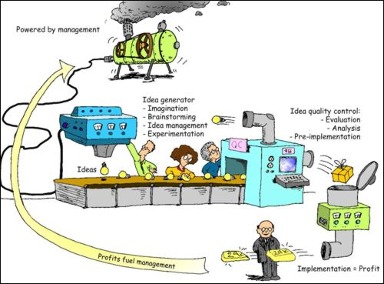
Mechanic organization
Strong centralization, formalization, specialization and standardization

Slide 19
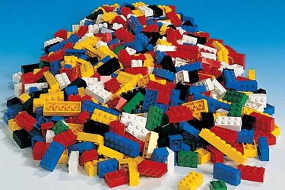
The current trend: Organic Organization
Flexible empowering type of structure (i.e., organic, learning, or boundaryless)
Fewer management levels and Broader spans of control
Lesser amounts of centralization, standardization, formalization, and specialization
Departmentation at the top of the firm can be either functional or divisional
Substantial freedom for lower-level managers and associates
Notes:
Everything good is “organic” nowadays!
I prefer the image of lego to organic metaphors (e.g. the cell or the organism), because organic organization are often characterized by what I call structural tinkering. These organizations undergo frequent reassembling and remodulation of their structure to adapt to changes in the competition, technology, etc.

Slide 20
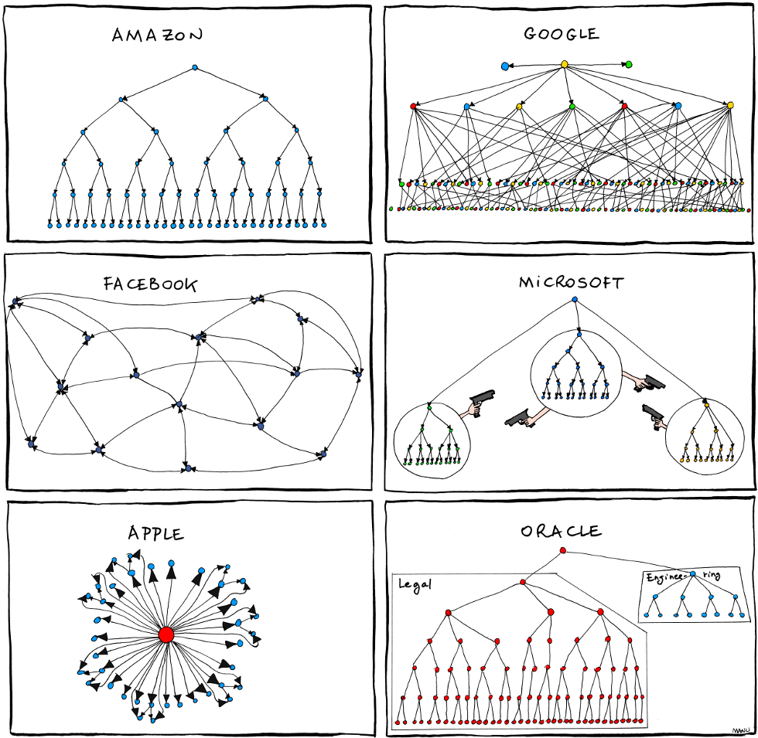
Examples of Organization
Notes:
Everything good is “organic” nowadays!
I prefer the image of lego to organic metaphors (e.g. the cell or the organism), because organic organization are often characterized by what I call structural tinkering. These organizations undergo frequent reassembling and remodulation of their structure to adapt to changes in the competition, technology, etc.

Slide 21
Matrix Organizational Structure
Tendencies toward anarchy
Power struggles
Severe groupitis
The mistaken belief that matrix management is the same as group decision making. The concept of teamwork was put in perspective: as often as necessary and as little as possible.
Collapse during economic crunch
Excessive overhead The fear of high costs associated with a matrix.
Who does it? A lot of companies are adopting Bechtel, Citibank, Dow Chemical, Shell Oil, Texas Instruments, and TRW…. And GE
Notes:
Tendencies toward anarchy
A formless state of confusion where people do not recognize a “boss” to whom they feel responsible.
Power struggles
Managers jockey for power in many organizations, but a matrix design almost encourages them to do so.
Take, for example, a company that has annual sales of $14 billion and employs about 400,000 people in scores of diverse businesses—General Electric. For decades, despite the diversity of its businesses, GE used one basic structure throughout its organization: five functional managers reporting to one general manager. Employing the logic that a company must organize to meet the particular needs of each business, some GE groups, divisions, and departments, which have found the pyramid form cumbersome, have turned to the matrix as a fundamental alternative.
“We’ve highlighted matrix organization. not because it’s a bandwagon that we want you all to jump on, but rather that it’s a complex, difficult, and sometimes frustrating form of organization to live with. It’s also, however, a bellwether of things to come. But, when implemented well, it does offer much of the best of both worlds. And all of us are going to have to learn how to utilize organization to prepare managers to increasingly deal with high levels of complexity and ambiguity in situations where they have to get results from people and components not under their direct control…
“Successful experience in operating under a matrix constitutes better preparation for an individual to run a huge diversified institution like General Electric—where so many complex, conflicting interests must be balanced—than the product and functional modes which have been our hallmark over the past twenty years.”

Slide 22
Organizational Structures
Project vs. Functional
Positives
Integration on projects
Customer focus
Responsibility assignment
Easier budget and cost control
Continuity in policies and procedures
Negative
Functional critical mass missing
Less technical expertise
Continuity – members do not have project security
Positive
Functional excellence
Expertise
Rapid reaction time
Focal point for out-of-company relations
Negative
No project integration
No project responsibility
Less customer focus
Shenhar, 1998
22
Notes:
The current types of organizational structure of project management are: functional organizational structure, project-based organizational structure and matrix organizational structure. 1. Functional organizational structure. Functional organizational structure is to be managed in the current organization hierarchical structure, once the project begins operation, the various components of the project are taken by the functional units, each unit is responsible for its charged component. If the the project established, a functional area play a dominant role, functional areas on completion of the project, senior managers will be responsible for project coordination. Advantages of this structure: First, the use of personnel with greater flexibility, as long as the choice of a suitable functional departments as the project supervisor, the department will be able to provide professional and technical personnel required by the project, and technology experts can also be used by different projects and after completion of the work can go back to his original work; Second, when the project team members leave or leave the company, the functions can be used as the basis for maintaining the continuity of the project; third, functional department can provide a normal career path for professionals. The disadvantage of this structure is: First, projects often lack of focus, each unit has its own core functions of general business, sometimes in order to meet their basic needs, responsibility for the project will be ignored, especially when the interest taken in the project brought to the unit not the same interest; Second, such organization has certain difficulties in the inter-departmental cooperation and exchanges; Third motivation is not strong enough for project participants, they think the project is an additional burden, and not directly related to their career development and upgrading; Fourth, in such organizational structure, sometimes no one should assume full responsibility for the project, often the project manager is only responsible for part of the project, others are responsible for the other parts of the project, which leads to difficulties in coordination situation. 2. Project-based organizational structure. Project organizational structure refers to the creation of an independent project team, the team’s management is separated from the parent organization’s other units, have their own technical staff and management, enterprise assigns certain resources to project team, and grant project manager of the largest free implementation of the project . The advantages of this structure: First, focus on this project team, project manager is solely responsible for the project, the only task for project members is to complete the project, and they only report to the project manager, avoiding the multiple leadership; Second, the project team’s decision is developed within the project, the reaction time is short; Third, in this project, members work with strong power, high cohesion, participants shared the common goal of the project, and individual has clear responsibilities. The disadvantage of this organizational structure: First, when a company has several projects, each project has its own separate team, which will lead to duplication of efforts and the loss of scalable economies; Second, the project team itself is an independent entity, prone to a condition known as “Project inflammatory” disease, that is, there is a clear dividing line between the project team and the parent organization, weakening the effective integration between project team and the parent organization; Third, the project team members lack of a business continuity and security, once the project ended, return to their original functions may be more difficult. 3. Matrix organizational structure. Matrix organizational structure is a hybrid form, it loads a level of project management structure on the functional hierarchical structure. According to the relative power of project managers and functional managers, in practice there are different types of matrix systems, respectively, Functional Matrix: in this matrix, functional managers have greater powers than project managers); Project Matrix: in this matrix, project managers have greater powers than functional managers); Balance Matrix: in this matrix, functional managers and project managers have the equal powers. The advantages of this organizational structure: First, it is the same as functional structure that resources can be shared in multiple projects, which can significantly reduces the problem of redundant staff; Second, project is the focus of work, with a formal designated project manager will make him give more attention to the project, and responsible for the coordination and integration work between different units; Third, when there are multiple projects simultaneously, the company can balance the resources to ensure that all the projects can progress to complete their respective costs and quality requirements; Fourth, the anxiety of project members is reduced greatly after the end of the project, while they are strongly associated with the project, on the other hand, they have a “home” feeling about their functions. The disadvantage is that this organizational structure: First, the matrix structure has exacerbated the tensions between functional manager and project manager; Second, under any circumstances, sharing equipment, resources and personnel among different projects will lead to conflict and competition for scarce resources; Third, in the process of project implementation, the project manager must negotiate and consult with the department managers on various issues, which leads to the delay in decision making; Fourth, matrix management is not according to the principles of unified management, project members have two bosses, the project manager and functional managers, when their commands are divided, it will make members at a loss. Three different forms of the matrix organizational structure does not necessarily have the advantages and disadvantages described above: Project Matrix can increase the project’s integration, reduce internal power struggle, its weakness is poor control of their functional areas and prone to “project inflammation”; Functional Matrix can provide a better system for managing the conflict between different projects, but maintaining the control of functions is at the cost of inefficient integration of projects; Balanced Matrix can achieve the balance between technology and project requirements better, but its establishment and management is very subtle, is likely to encounter many problems related to matrix organization.
https://www.projectsmart.co.uk/forums/viewtopic.php?t=730

Slide 23
Organizational Structures
Matrix – Need to Balance, In-Between Structure
Positive
Integration and Functional Excellence
Better utilization of resources
Negative
Two boss system
Different agenda
Different leadership styles
Built in conflict
Shenhar, 1998
23

Slide 24
Selecting the Organizational Form
No best way… organizational structure does not mean project success!
If it is a “How” question, the functional team deals with it.
If it is a “What” question, the project team deals with it.
Who has more power? – Depends on the culture.
Project
Project-Matrix
Matrix
Functional-Matrix
Functional
Shenhar, 1998
24

Slide 25
Factors affecting structures
Size
Strategy
Structure
Environment
Technology
Notes:
Size matters: small companies tend to have very simple structures, characterized by few levels with high centralization, low standardization and functional specialization
In very small company structure is not an issue, what really matters are the interpersonal dynamics between the entrepreneurs and their employees (if any) or within the team of entrepreneurs

Slide 26
Factors affecting structures
Size
Strategy
Structure
Environment
Technology
Notes:
Size matters: small companies tend to have very simple structures, characterized by few levels with high centralization, low standardization and functional specialization

Slide 27
Factors Affecting Structure
Strategy: Two levels Corporate & Business
Corporate strategy
Growth: internal VS acquisition
Diversification: supporting structure includes
Divisional form
Delegation of authority to the divisions
Notes:
What is strategy?
Corporate VS business level: corporate is the highest level. It is a competence of the top management and top managers make decisions about what markets and businesses the company should be in, or on how the several businesses should be better integrated. The Business strategy is the strategy pursued by the company in a specific sector or market, it is subordinate to the corporate strategy and it is the responsibility of Business units directors
Internal growth is often propelled by large R&D and/or marketing structures (see Fed Ex opening case in chapter 13 of the textbook)
Diversification means to add new product/services (risk reduction) and /or enter new markets: typically this implies the adoption of a divisional form to increase proximity to market and local autonomy at the business unit level

Slide 28

Diversification Strategy and Structure
Exhibit 13-4
Matches between Diversification Strategy and Structure
Diversification Structure
Single or dominant product Functional (U-form)
Dominant product (several related products) Divisional (M-form)
Unrelated product Holding
Notes:
U form is typical of small medium companies with a specific market focus and limited geographic scope
M form is typical of large companies operating in multiple markets and producing different but related products (e.g. automotive companies)
Holding are common in media, bank and finance, but also some industrial giants are holding like samsung (phones, TVs, washing machines, cameras, …)

Slide 29
Factors Affecting Structure
Strategy
Business strategy
Low cost/low price: supporting structure includes
Pursuit of efficiency through standardization and centralization
Product/service differentiation: supporting structure includes
Flexibility and initiative
A more organic structure
Notes:
What is differentiation? Examples of companies that pursue this strategy?
What is low cost? Examples?

Slide 30
Factors affecting structures
Size
Strategy
Structure
Environment
Technology

Slide 31
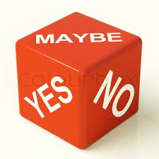
Role of the Environment
Environment and basic structure
Environmental uncertainty
Effective organizations experiencing high environmental uncertainty tend to be more organic
Adaptation metaphor
Notes:
Why more uncertainty requires autonomy? Examples, please
In highly uncertain environment organizations need local responsiveness because there is not enough top down knowledge to standardize behavior and operations at the top management level. Middle managers and even associates need autonomy and have to show adequate problem solving skills and attitude. If the reaction has to be fast, there is no time that can be wasted waiting for the information to travel to the top levels of the hierarchy and come down in forms of orders to execute because each level of approval will slow down the process
Quote Lawrence and Lorsch study

Slide 32

Role of the Environment
Environment and integration
Structural arrangements that address information needs are particularly important when the environment is uncertain
Notes:
Why more uncertainty requires more integration?
Because more uncertainty is often related to higher complexity and higher complexity requires more interaction and interdependence: Mechanic organizations are too rigid to react quickly and adapt. What makes an organism different from a machine? The higher interconnection and interdependence between each subsystem
Organizational designers spend a lot of their time and effort to identify adequate ways to divide labor and task across different units and individuals. However, they also take into account how the different parts of an organization have to work together by exchanging information among them. Integration is the design of organizational mechanism aimed at facilitating interaction, sharing and coordination

Slide 33
Integration in Organizations
Integration in Organizations
Lateral Relations
Lateral Relations
Information Technology
Information Technology
Increasing Richness of Information Processing
Increasing Richness of Information Processing
Self-contained Tasks
Self-contained Tasks
Slack Resources
Slack Resources
Increasing Implementation Complexity
Notes:
Slack resources is about the availability of excess capacity: over-abundance reduce the need for tight integration or communication between two or more departments. An example is to have larger than optimal warehouse serving more than one internal client. The over-supply neutralize the need for two clients to coordinate
Self-contained task: a process can be segmented in steps and steps allocated to different units. This favors specialization but also needs tight coordination between the involved units. In some cases it could be preferable to have a single process owner: the driver is usually increasing customer service level (e.g. ACI example) or reduce workers alienation (work station)
IT just automates coordination through efficient and pervasive information sharing, it helps to reduce slack
Lateral relations are typically about mixing individuals from separated units for joint work or information sharing

Slide 34
Lateral Relations
Direct Contact
Liaison Roles
Matrix Designs
Lateral Processes
Taskforces & teams

Slide 35
Structural Characteristics: Departmentation
Matrix
CEO
VP
HR
VP
Operations
VP
Marketing
sales
VP
R&D
VP
Purchasing
Product
Manager A
Product
Manager B
Product
Manager C
Product
Manager D
= shared resource, may have a liason role
Notes:
Mention hybrid structures

Slide 36
Factors affecting structures
Size
Strategy
Structure
Environment
Technology

Slide 37
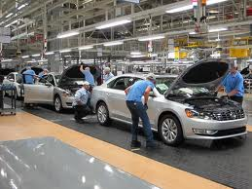
Technology and Structure
Manufacturing
Small-batch technology
Few management levels and few managers
Skilled craftsmen and craftswomen
Work is varied, requiring independent judgment of associates
Mass-production technology
More management levels and more managers per associate
Associates handle relatively routine jobs in a less organic environment
Staff specialists and managers design procedures in advance
Notes:
Technology in a broader sense here refers to knowledge and processes required to accomplish tasks and techniques to transform inputs in outputs
Small batch: hospital, universities, and any other type of sophisticated, highly customized service
Mass production: automotive, computer industry

Slide 38
Technology and Structure
Manufacturing
Process technology
Even more management levels and more managers per associate
Tall hierarchies designed for monitoring various aspects of the organization
Lower-level associates enjoy some level of discretion, as they must be free to act in emergencies
Lower-level associates in process organizations are plant operators and maintenance specialists with strong training
Mass customization
Flexible, organic environment
Notes:
Process technology: chemical plant
Mass customization: software companies (Google)

Slide 39
Technology and Structure: Broader Framework
Technology
Task variability: the number of different problem types that are encountered over time and
Task analyzability: the degree to which problems can be solved using known steps and procedures

Slide 40
Diversification Strategy and Structure
Engineering
Non-Routine
High
Specialized Engineering Consulting Firm
Research and Development Firm
Task Variability
Routine
Craft
Low
Mass-Production Firm
School
High
Low
Task Analyzability

Slide 41
Organizational Culture
For Edgar Schein organizational culture is:
A set of shared basic assumptions
Invented, discovered or developed by a group
In an attempt to resolve the twofold problem of external adaptation & internal integration
that have worked reasonably well in the past in order to be considered valid and that therefore
Must be taught to new members of the group as
The correct way to perceive, think and feel in relation to certain specific problems
Notes:
Organizational culture
The values shared by associates and managers in an organization

Slide 42
Organizational Culture: why does it matter?
Shared Values
Reinforcing Outcomes
Organizational Culture
Norms
Individual and Group Behavior
Notes:
Organizational culture is self-reinforcing and act subtly on individual and group behavior because it is about what is fair/unfair, right/wrong, socially acceptable/

Slide 43
Organizational Culture: Why does it matter?
Artifact
Visible organizational structures and processes
Culture can be observed
at several levels
Exposed Values
The declared organization’s strategies, goals and philosophies
Shared Tacit assumptions
Unconscious, taken-for-granted beliefs, perceptions, thoughts, and feelings: the way we do things around here”
Notes:
Organizational culture influences strategy and structure of an organization
Culture can be observed at several levels
Artifacts can be physical layout, overt behavior, formal description, plans, procedures (e.g. Stevens honor sign, Stevens honor reminder in the syllabus)
Exposed values are declared (see Stevens policy and declarations on students plagiarism))
Shared assumptions are basic values, taken for granted, most of the times obvious for the organization (students must be rewarded in function of their individual merit)
b and c may be actually misaligned (ex. “we reward individual merit” but in fact we hire based on ethnical origin or the organization reinforces honest behavior but in practice students cheat often)

Slide 44
Differentiation of Culture
Subcultures: organizations can be differentiated with respect to the culture of different organizational units
A sense of “separateness” can create a counter culture
Notes:
Subcultures can characterize separated groups within a same organization, e.g.
Business units, for instance post-acquisition
Functional units (a classic theme is R&D culture VS marketing culture)
Work or project teams can develop their own subculture if work together for enough time)
Professional communities (engineers, salesmen, etc.)
International factors (mention Hofstede research with IBM)

Slide 45
Organizational Culture
Clan
Adhocracy
Flexibility/Discretion
Leadership
Mentors and Coaches
Leadership
Entrepreneurs and Innovators
Effectiveness
Cohesion and Morale
Effectiveness
Creativity and Innovation
Hierarchy
Market
Leadership
Monitors and Organizers
Leadership
Hard Drivers and Competitors
Stability/Control
Effectiveness
Efficiency and Order
Effectiveness
Goal Achievement and Winning
Internal Focus/Integration
External Focus/Differentiation
Notes:
Can you make examples of organizations adoption mainly one type of culture?
e.g. what would you expect for
An hospital? Clan
An academic dept? Clan + Adhocracy
A large multi-divisional corporations? Market
Real estate company? Market
Army? Hierarchy

Slide 46

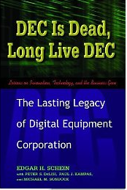
Case study: DEC is dead, long live DEC
A cultural explanation of why a leading company fails
What is organizational culture?
Summarize DEC cultural DNA
Summarize the major changes the computer industry was undergoing during the DEC’s history
Can you identify some of the causes of DEC inability to catch up with the industry evolution among the company cultural genes?

Slide 47
Work with other groups to decide on specific companies to research - so we have variety (for example, 1 tech (like google/paypal/yahoo etc), 1 bank, 1 oil business, 1 manufacturing, 1 retailer (walmart, Zara), 1 hybrid (tech + retail) like Amazon), 1 electronics (sony/samsung).
Slides should include:
1 Graphical representation of the company
2 Your thoughts as to why they have this structure (there is not a wrong answer and you may research it)
3. Is this the right structure?
If you have time to do more than one in your area (say tech).
Slides to be posted as group to Assignments before 7pm.
This is for discussion purposes and team collaboration.
Example companies:
Exxon-Mobil
Google Facebook
Dow Chemical 3M
General Electric IBM
Bank (any)

Slide 48
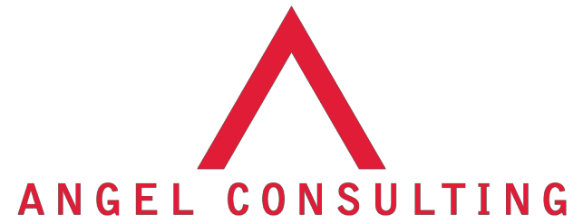

Business Policy
University of Guelph-Humber BADM 4000
Charles Janthur
Presentation Date
July 27, 2015
Mark Bilhete
Timothy Brilhante
Narinder Dhaliwal
Savanna Fernandes
Jelisaveta Knezevic
Karen Macwan

Slide 49
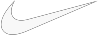
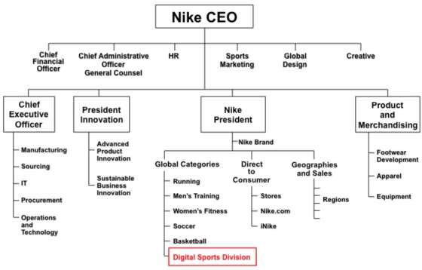
ORGANIZATIONAL STRUCTURE
Digital Chief Officer
"It’s a mix. Traditional hierarchic top-down is archaic, it’s just not real. On the other side, everything is not bubble-up. That ratio, top-down to bubble-up, will shift based on situations. I’m a big believer that there’s no one single approach." - Mark Parker, CEO

Slide 50
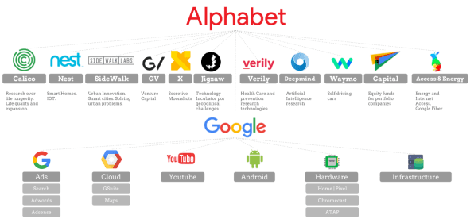

Slide 51
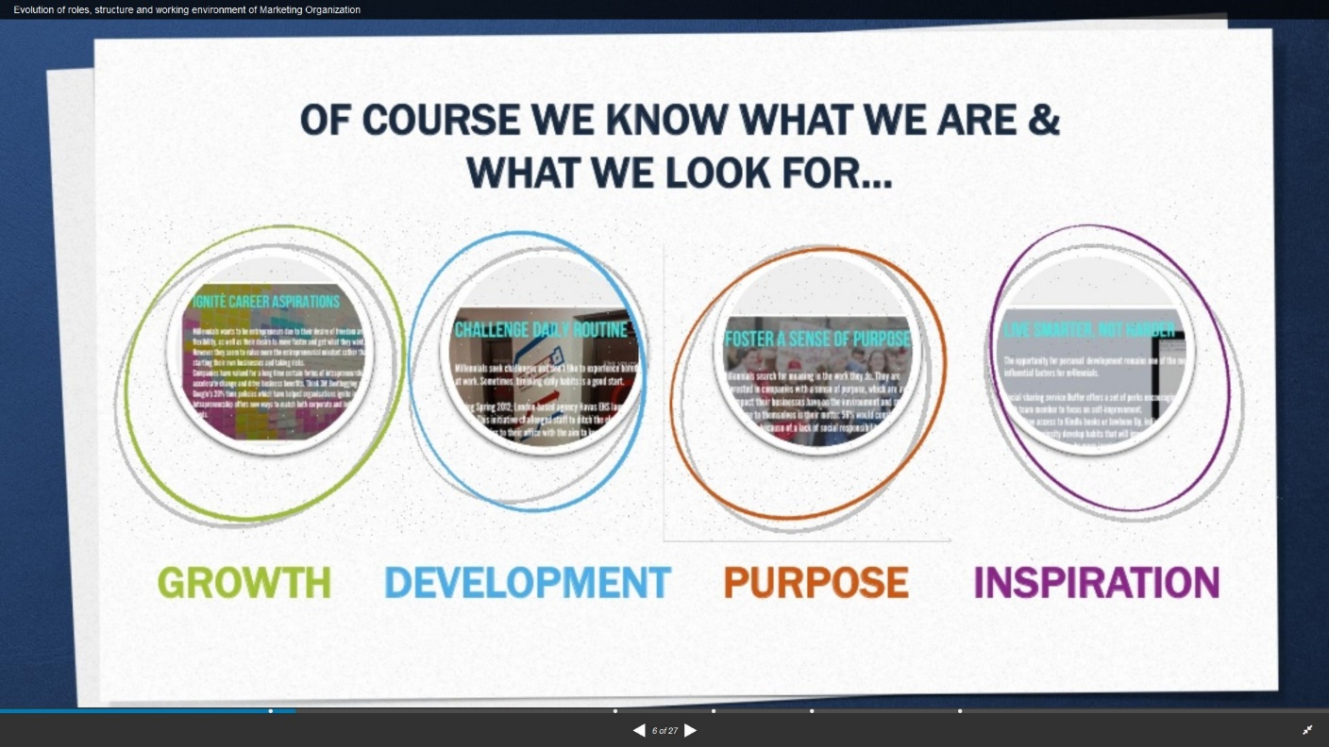

Slide 52
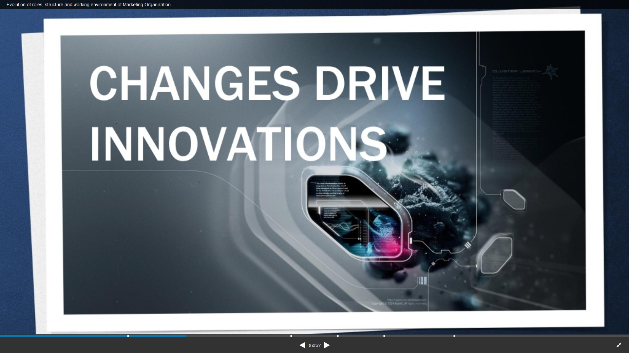

Slide 53
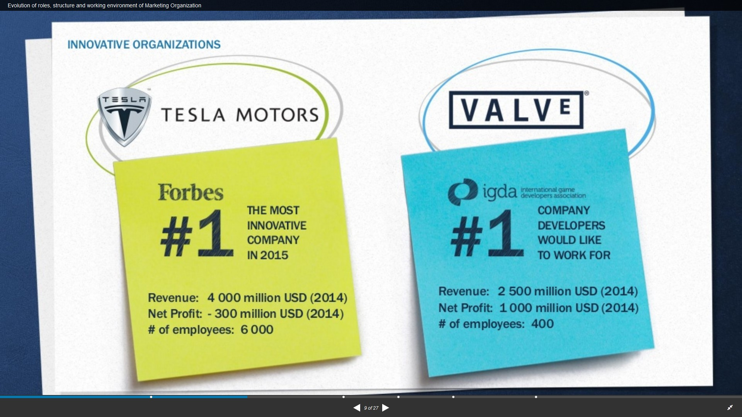

Slide 54
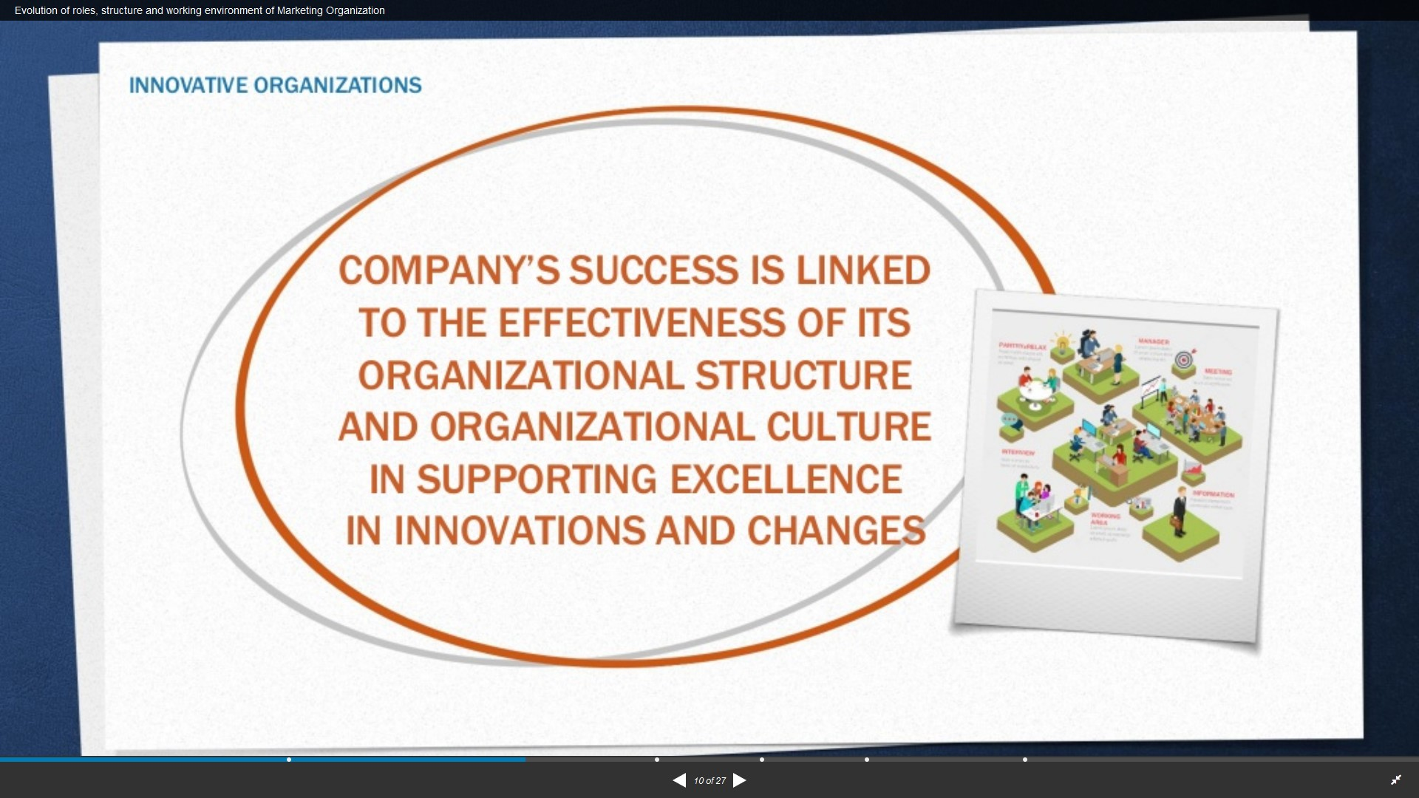

Slide 55
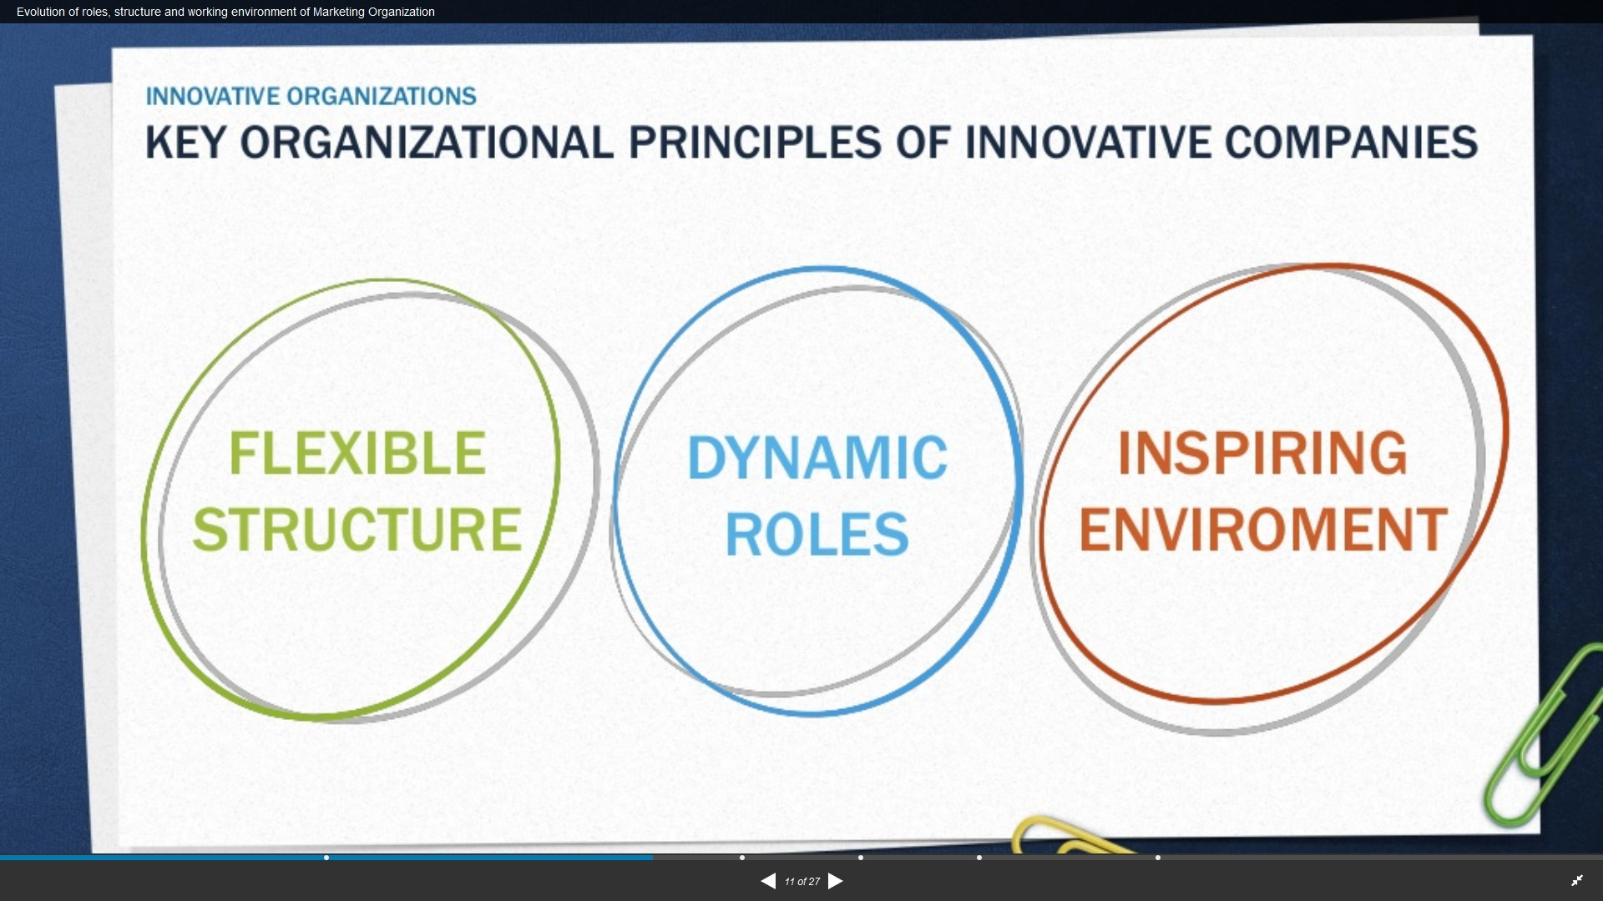

Slide 56
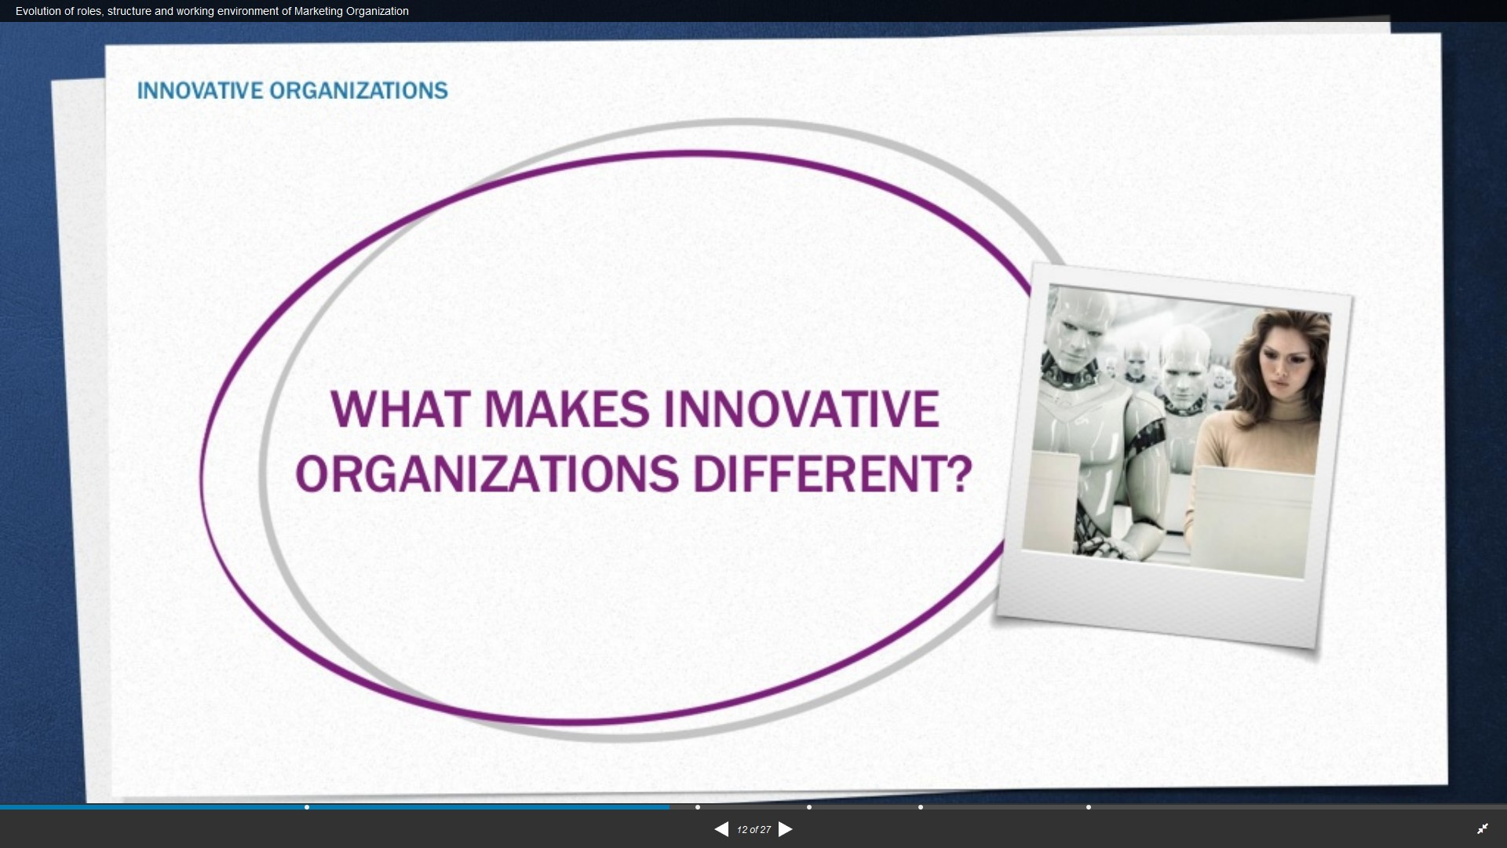

Slide 57
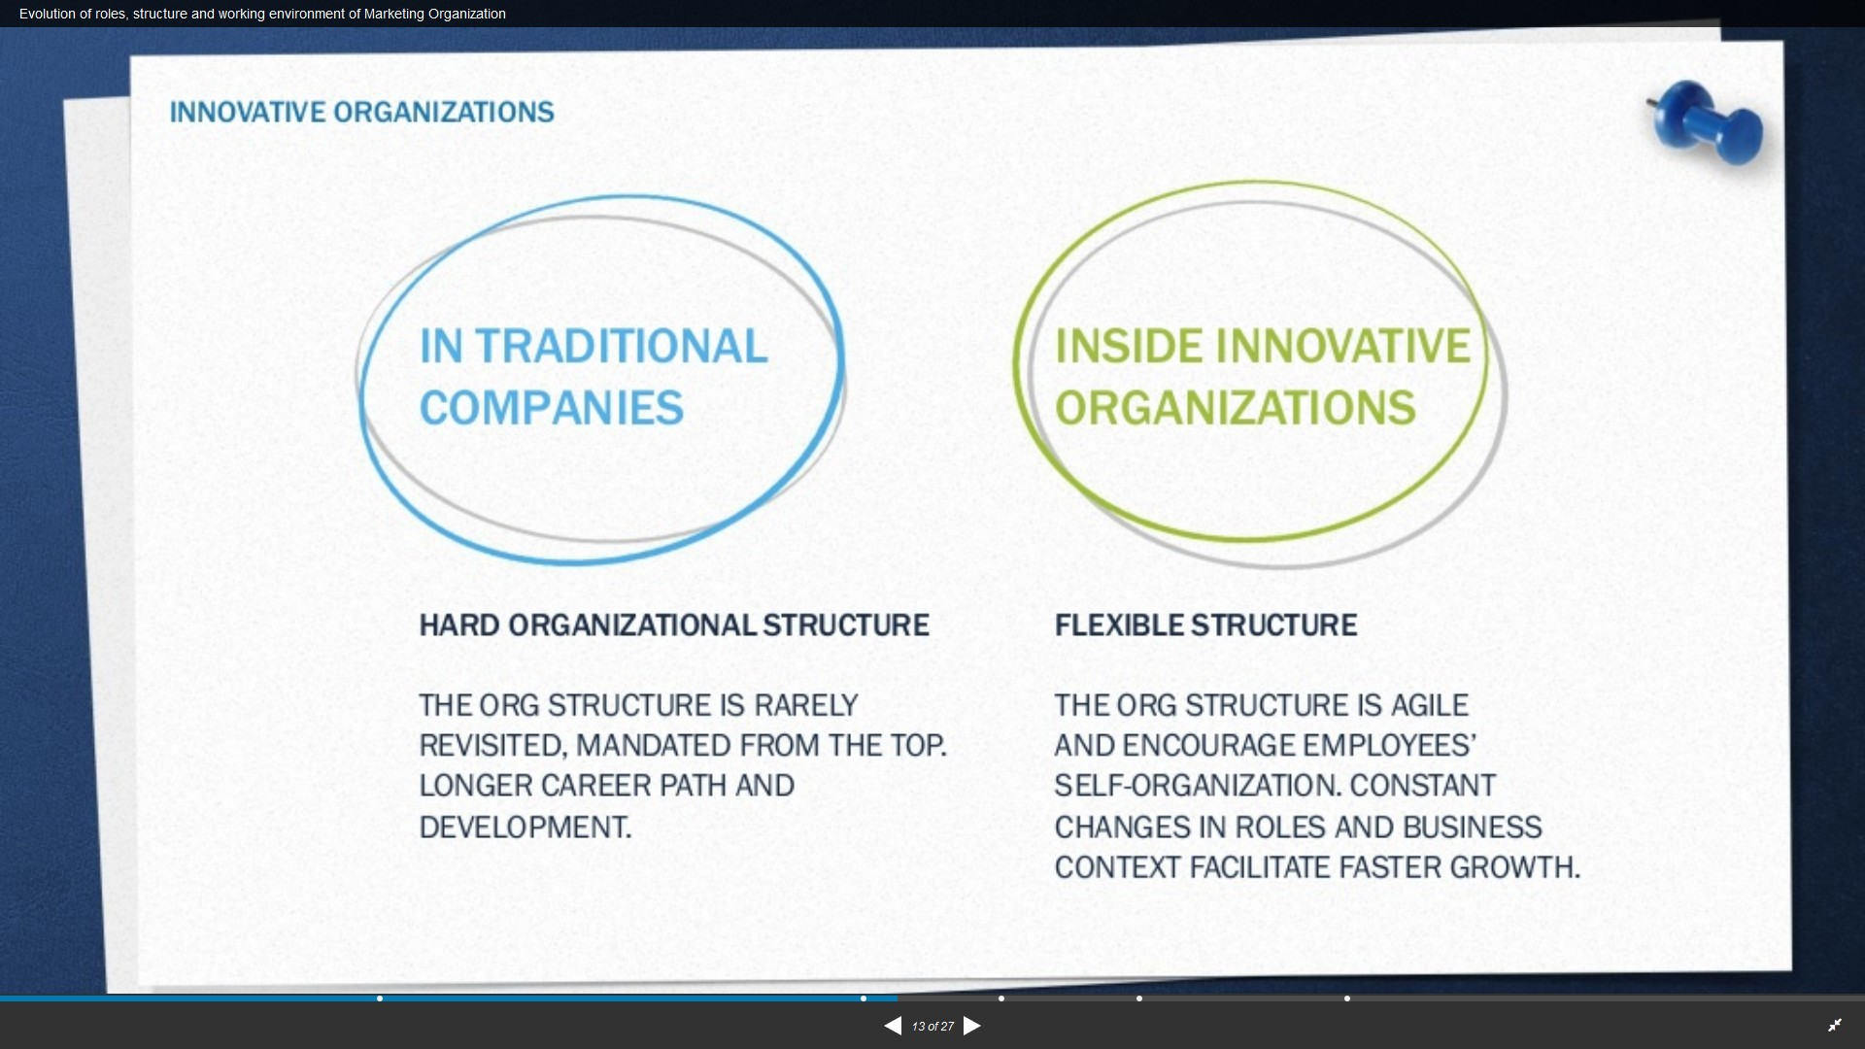

Slide 58
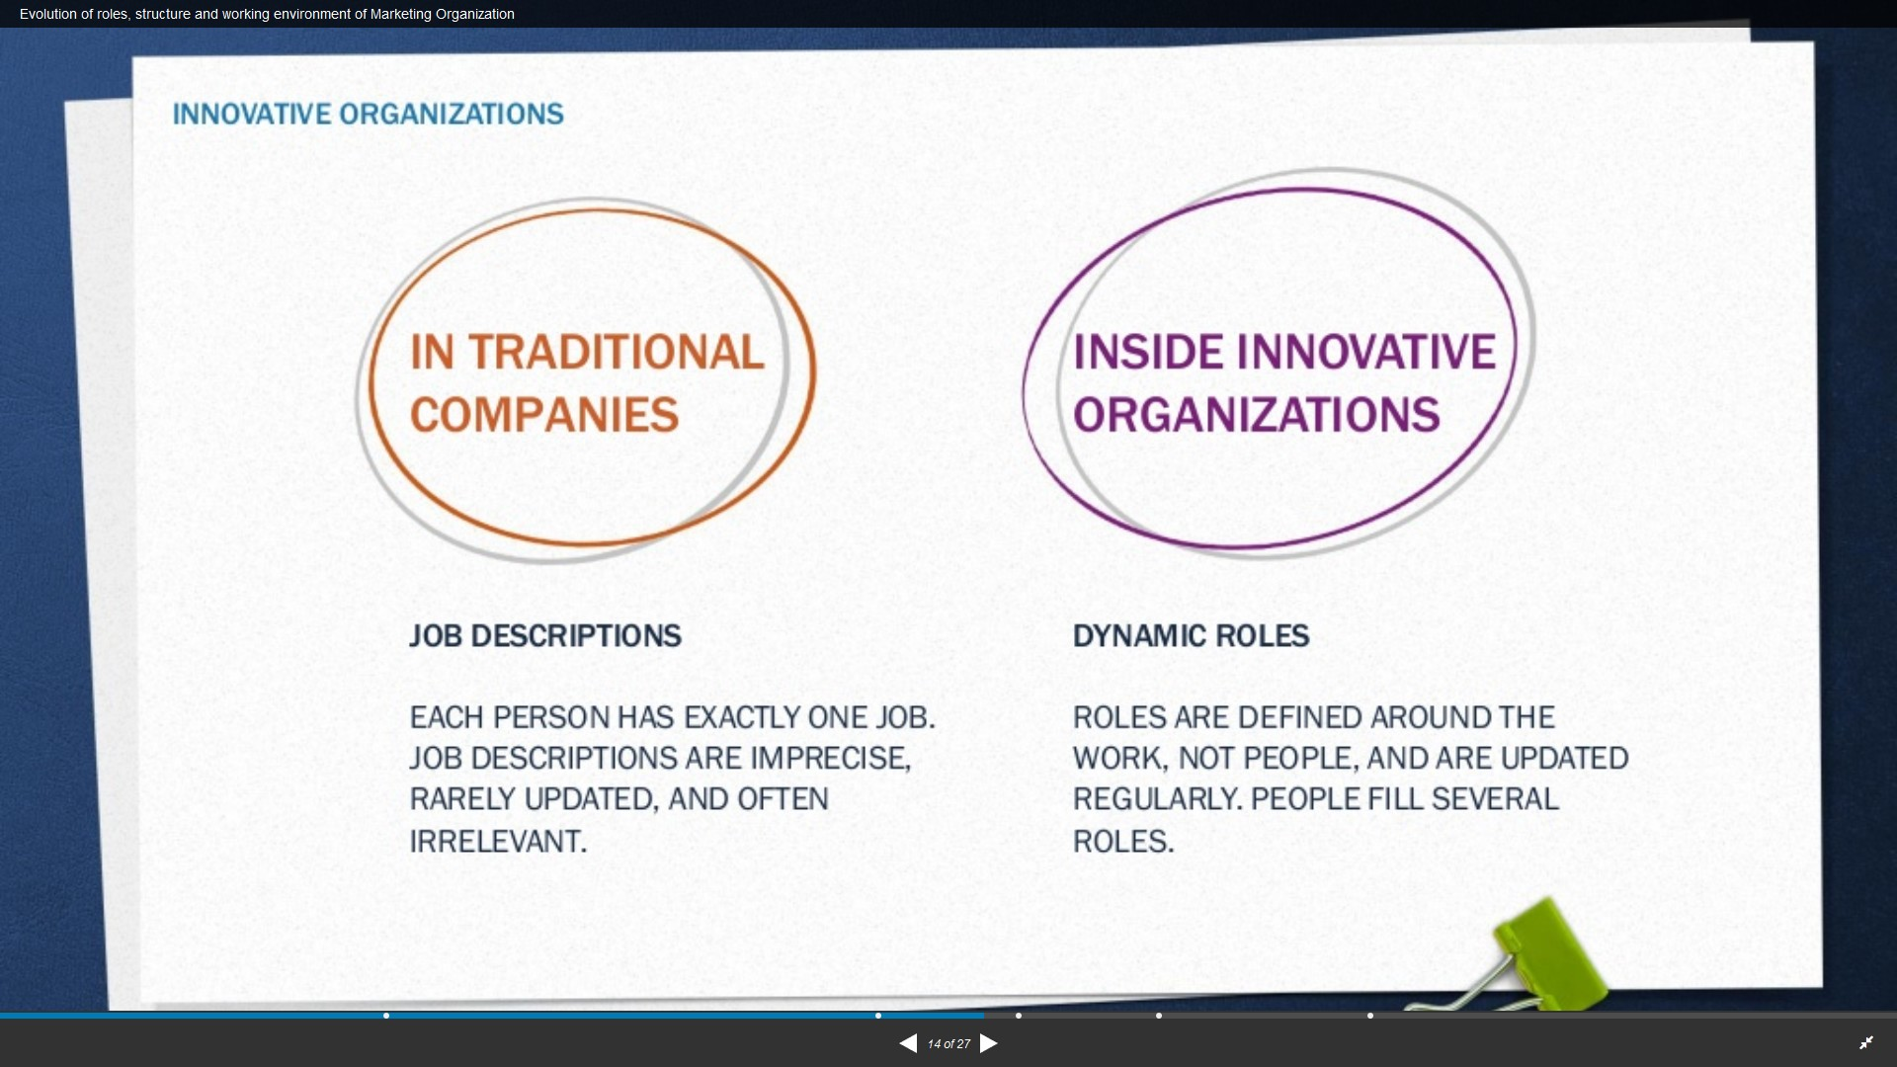

Slide 59
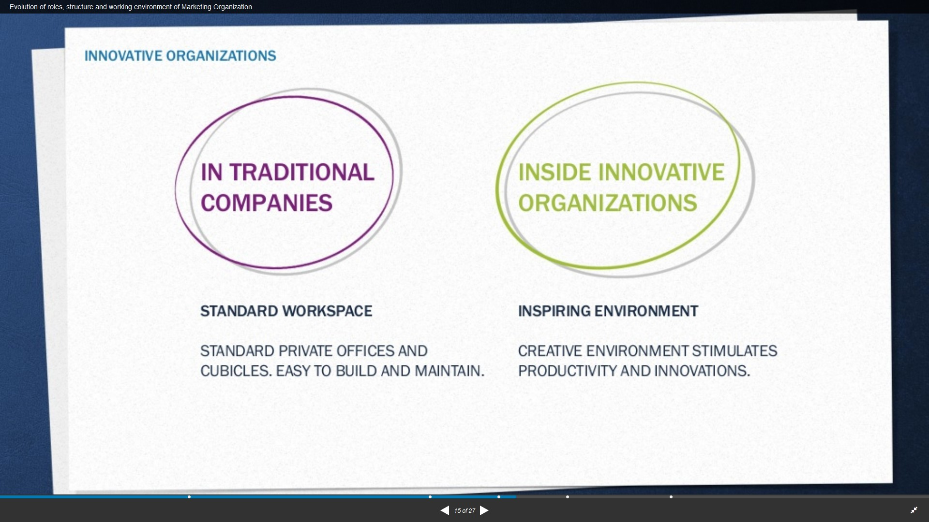

Slide 60
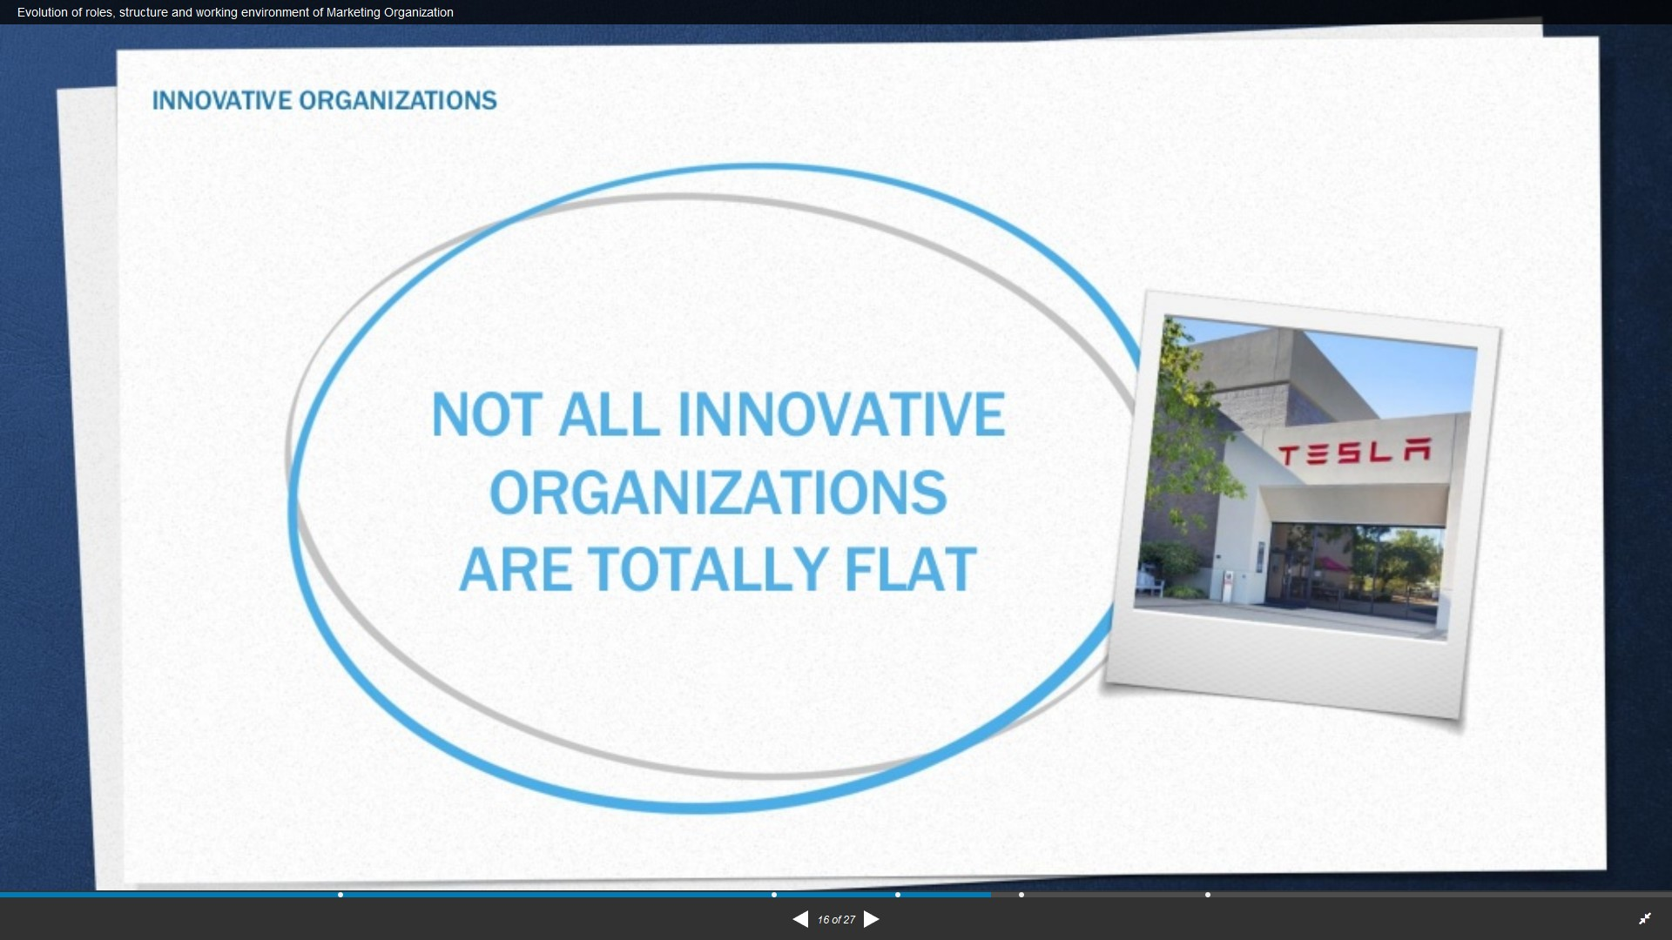

Slide 61
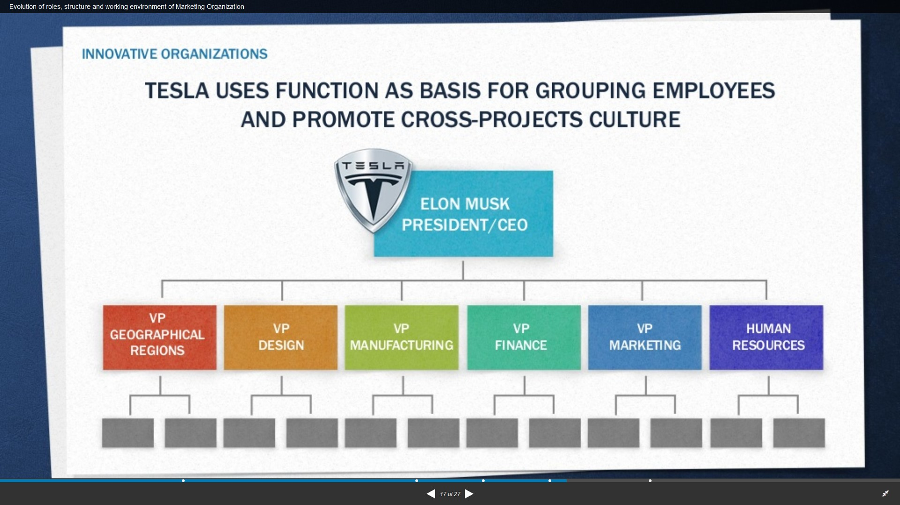

Slide 62
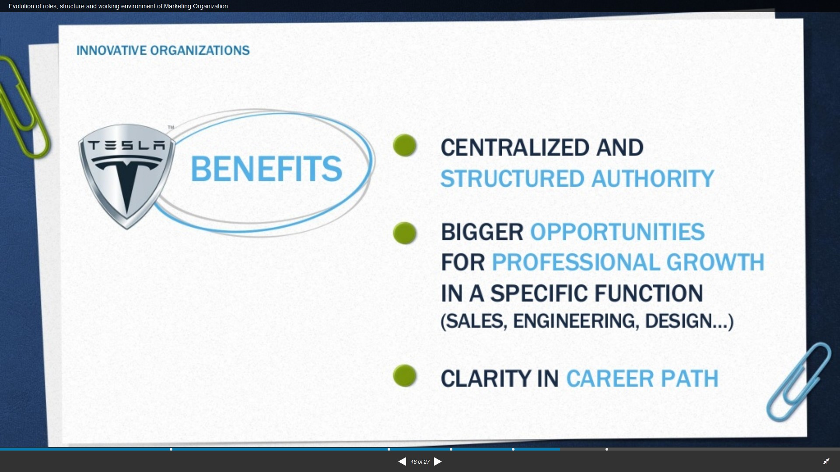

Slide 63
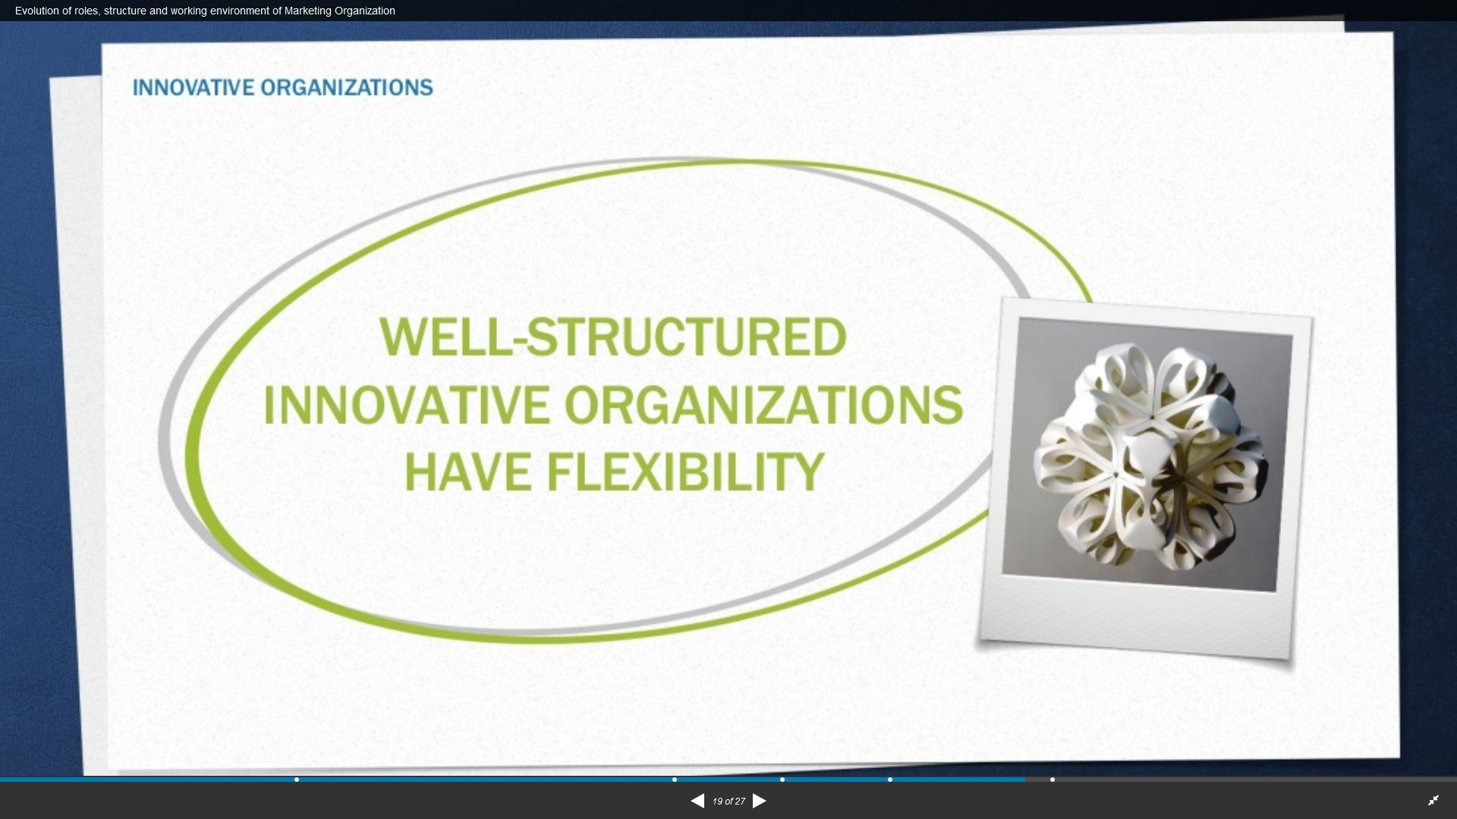

Slide 64
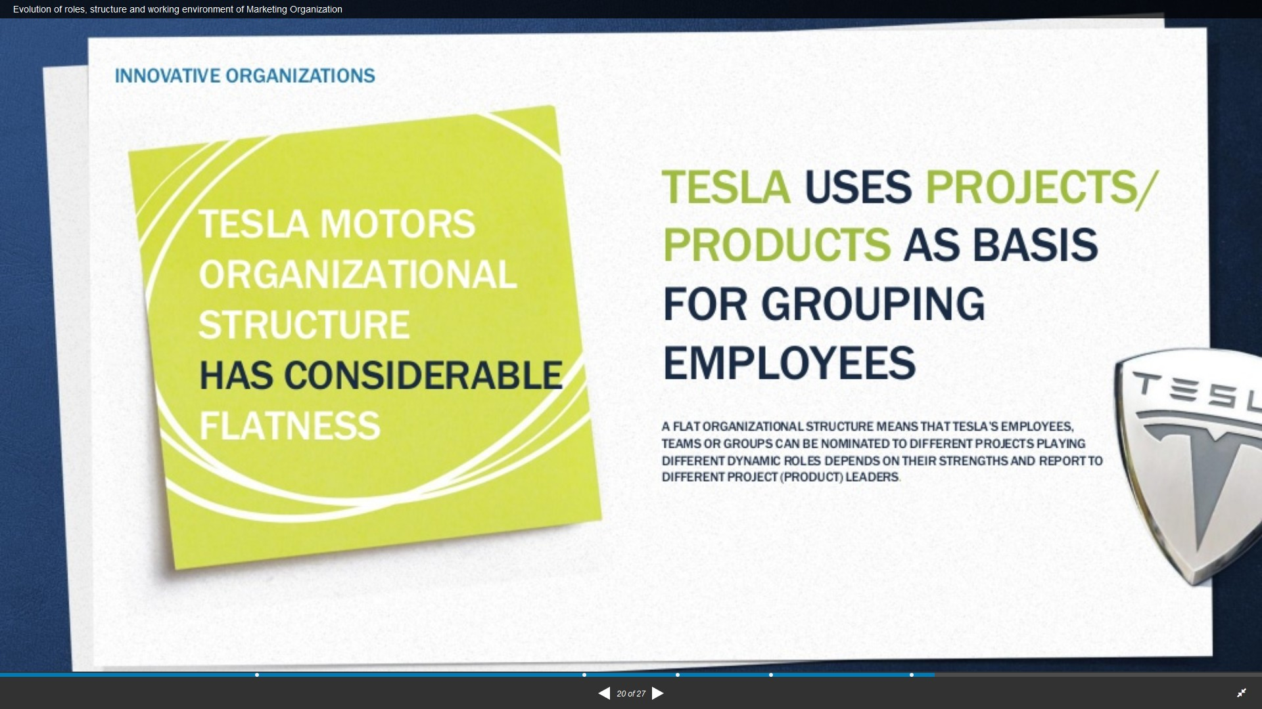

Slide 65
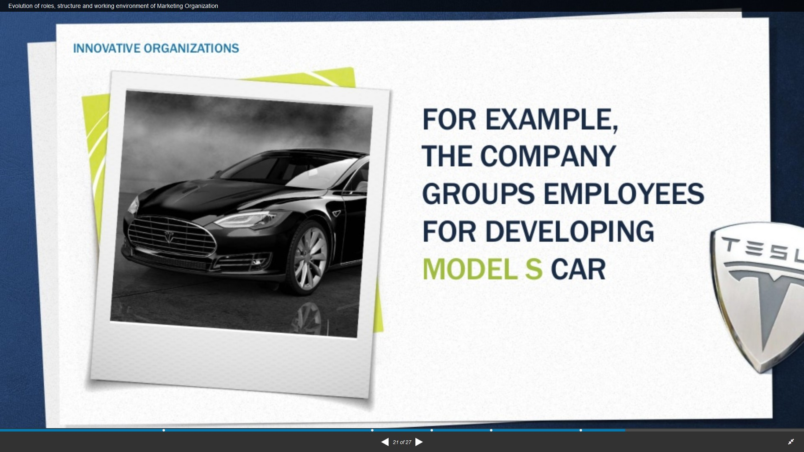

Slide 66
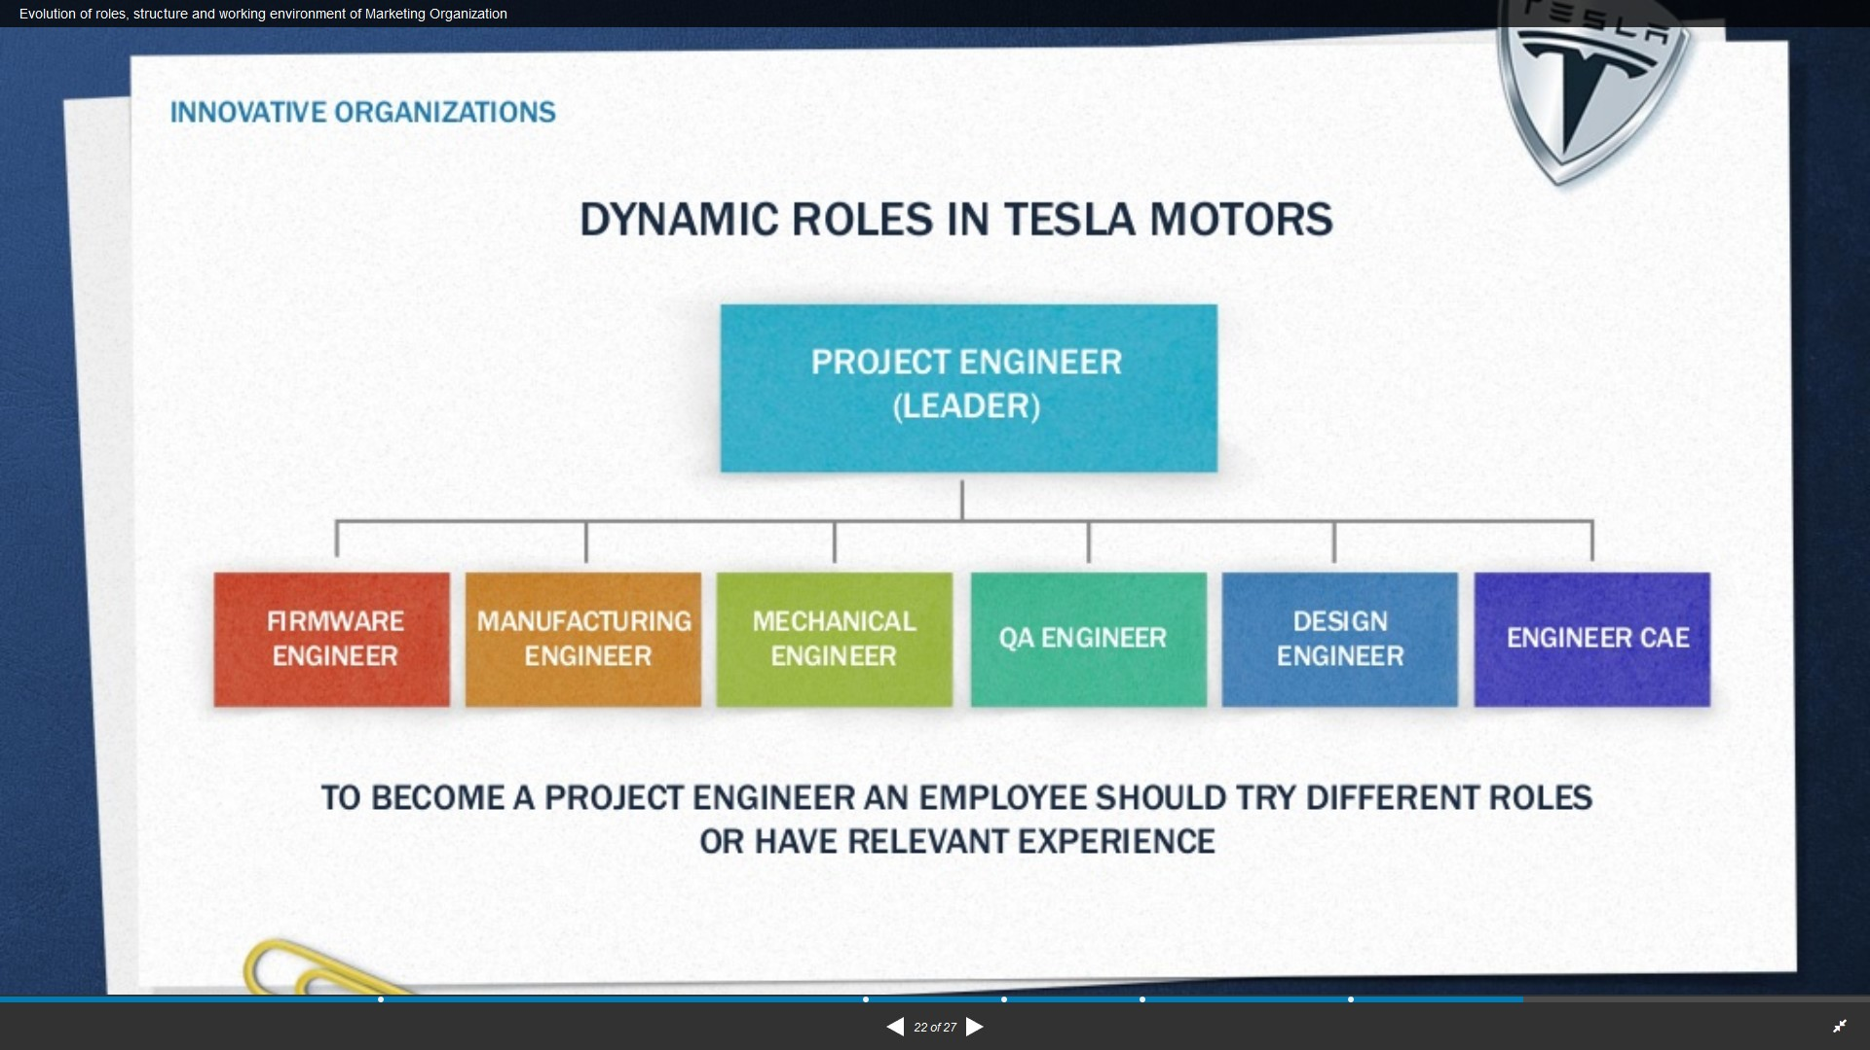

Slide 67
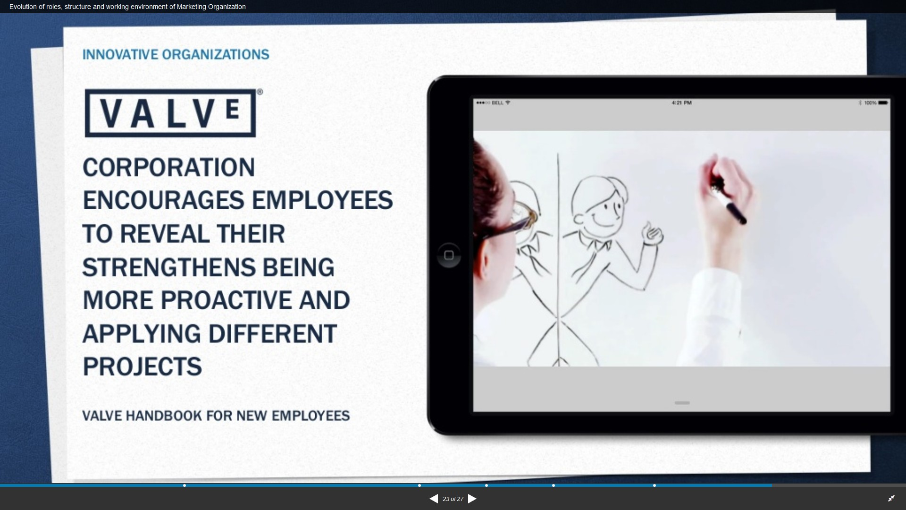

Slide 68
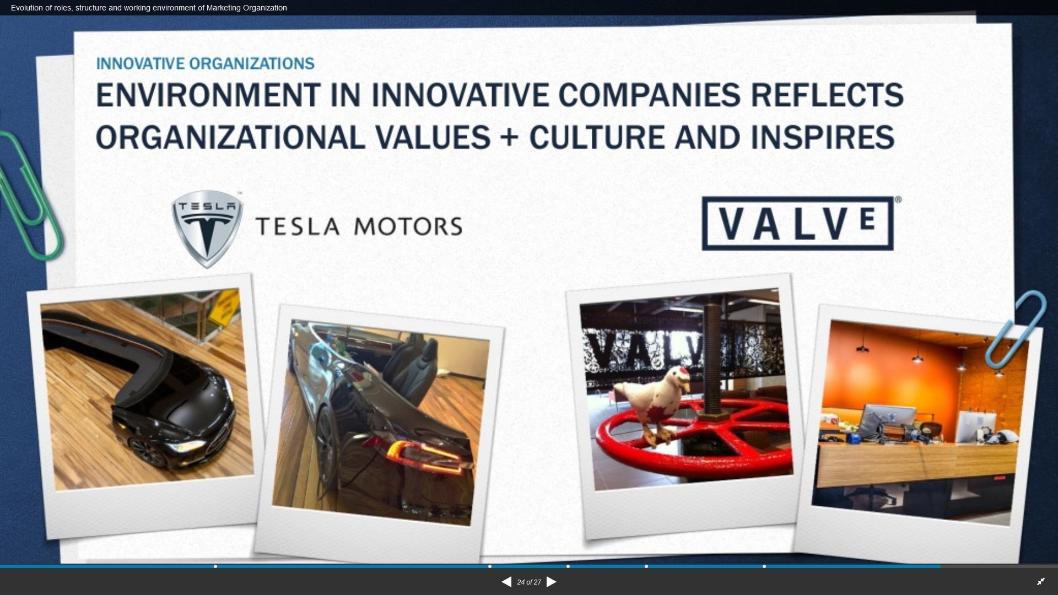

Slide 69
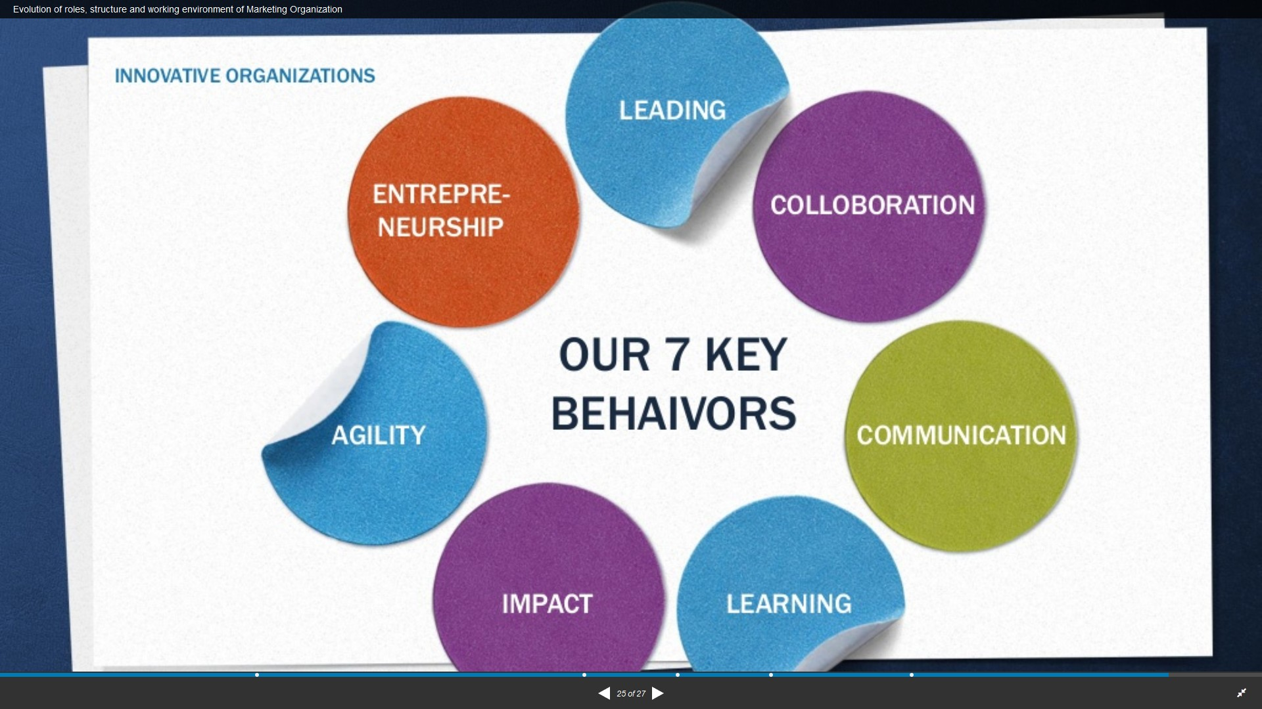

Slide 70
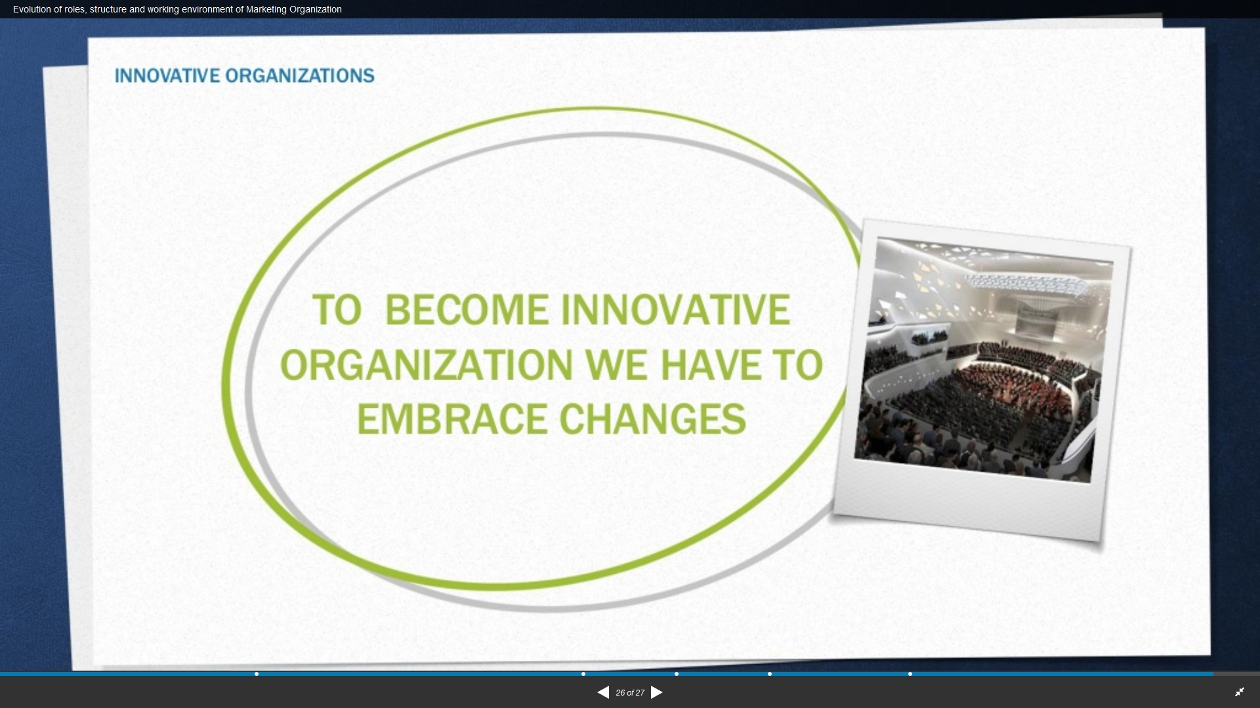

Slide 71
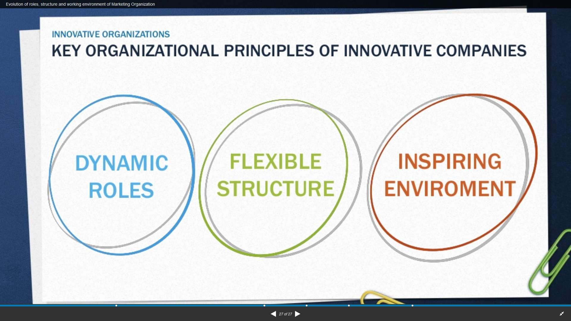

Slide 72
PROBLEM 2 – CORPORATE LEADERSHIP
PROBLEM ANALYSIS
KEY ISSUE
Tesla’s performance has been slow to improve due to the current corporate leadership approach
Overdependence on CEO Elon
Musk for strategic direction
Role duality within corporate structure hindering effective decision-making
Need for leadership balance
between vision and management
CFO Deepak Ahuja’s retirement

Slide 73
PROBLEM 2 – RECOMMENDATION
CORPORATE
GOVERNANCE
REVISE CORPORATE STRUCTURE
STRATEGIC
LEADERSHIP

Slide 74
EXHIBIT 2.1 – CURRENT CORPORATE STRUCTURE
Shareholders
Board of Directors
Elon Musk
CEO, Product Architect, Chairman & Board of Director
JB. Straubel
CTO
J. Vijayan
CIO
D. Ahuja
CFO (Retiring)
D. O’Connell
VP Business Development
P. Carlsson
VP Supply Chain
J. Guillen
VP WW Sales

Slide 75
EXHIBIT 2.2 – REVISED CORPORATE STRUCTURE A
Shareholders
Board of Directors
Elon Musk
CEO, Product Architect & Board of Director
NEW CHAIRMAN
President & Board of Director
(New Position – Managerial Leader)
JB. Straubel
CTO
J. Vijayan
CIO
D. Ahuja
CFO (Retiring)
COO
(New Position)
D. O’Connell
VP Business Development
P. Carlsson
VP Supply Chain

Slide 76
ADVANTAGES FOR TESLA
Elon Musk can focus entirely on leading Tesla as CEO
President can help achieve synergy between vision and management
Tesla’s corporate governance will be more effective in terms of
accountability and transparency
Better performance, decision-making, and response to change

Slide 77
EXHIBIT 2.3 – REVISED CORPORATE STRUCTURE B
Shareholders
Board of Directors
ELON MUSK
Product Architect,
Chief Executive Officer
(New Strategic Leader / Vision + Management)
Chairman & Board of Director
President & Board of Director
(New Position – Managerial Leader)
JB. Straubel
CTO
J. Vijayan
CIO
D. Ahuja
CFO (Retiring)
COO
(New Position)
D. O’Connell
VP Business Development
P. Carlsson
VP Supply Chain

Slide 78
ADVANTAGES FOR TESLA
Elon Musk is also the CEO of SpaceX and Chairman of SolarCity
Appointing a new CEO will allow Elon Musk to focus on multiple
responsibilities more efficiently, while remaining Chairman of Tesla
Tesla will benefit from strategic leadership with both vision and
management effectiveness
Potential candidate: Calin Rovinescu, CEO of Air Canada
Helped Air Canada through bankruptcy and returned it to profitability in 2014
with a 4% profit margin

Slide 79
SYNTHESIS
STEERING TESLA IN THE RIGHT DIRECTION
Ultimately lead to improvements in Tesla’s performance and strategic direction
Strategic recommendations include a new JV and revised corporate structure
Tesla must address its production capacity and corporate leadership issues

Slide 80
Thank You

Slide 81
REFERENCES
Boeing. (2015, July 20). Our Company. Retrieved from Boeing: http://www.boeing.com/company/
Euromonitor International. (2015, July 20). Automotive Industry Analysis. Retrieved from Euromonitor International: http://www.portal.euromonitor.com.rap.ocls.ca/portal
Hason, S. (2015, June 19). Tesla Motors Inc Secures $15M In Tax Credits In California. Retrieved from Business Finance News: http://www.businessfinancenews.com/22742-tesla- motors-inc-secures-15m-in-tax-credits-in-california/
Hitt, M. A., Ireland, R. D., Hoskisson, R. E., Rowe, W. G., & Sheppard, J. P. (2009). Strategic Management: Competitiveness and Globalization Concepts (3rd ed.). Toronto, ON, Canada: Nelson Education.
Nasdaq. (2015, July 20). Crude Oil WTI (NYMEX) Price.
Retrieved from Nasdaq:
http://www.nasdaq.com/markets/crude- oil.aspx?timeframe=5y
Tesla Motors. (2014, December 31). Annual Report.
Retrieved from Tesla Motors: http://ir.teslamotors.com/secfiling.cfm?filingID=15645 90-15-1031&CIK=1318605
Tesla Motors. (2015, July 20). About Tesla. Retrieved from Tesla Motors: http://www.teslamotors.com/about
Tesla Motors. (2015, July 20). Blog. Retrieved from Tesla Motors: http://www.teslamotors.com/blog
Tesla Motors. (2015, July 20). Forums. Retrieved from Tesla Motors: http://my.teslamotors.com/forum/forums/tesla- timeline-0
All images sourced from Tesla and Boeing websites.
28

